Slide 1

Kernel-level rootkit
Yilei Xu, Cristina Garbacea

Slide 2

What is a rootkit?
Computer software (typically malicious), designed to enable access to a computer or areas of its software normally not allowed
can mask its existence or the existence of other software
“root” + “kit”: negative connotations (malware) - root: privileged account on Unix like operating systems - kit: software components that implement the tool
Notes:
If an intruder could replace the standard administrative tools on a system with a rootkit, the intruder could obtain root access over the system whilst simultaneously concealing these activities from the legitimate system administrator.

Slide 3
Installation
automated or installed by an attacker, once they obtain root or administrator access
once installed, it is possible to hide the intrusion while keeping privileged access
consequence: existing software can be modified
Notes:
including software that might otherwise be used to detect or circumvent it

Slide 4
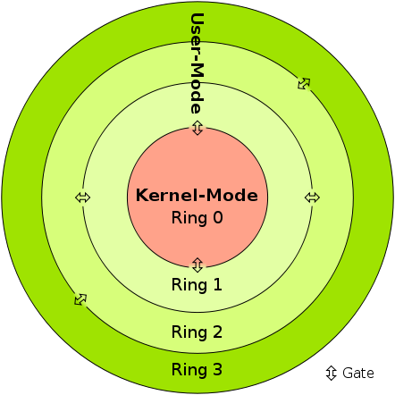
Rootkit types
Kernel mode: runs with the highest privileges, can modify data structures
User mode: run along with other applications as user
Hypervisor level: hosts the target operating system as a virtual machine
Firmware and hardware: uses device or platform firmware to create a persistent malware image in hardware (router, network card, hard drive, or the system BIOS)
Notes:
Kernel-mode rootkits run with the highest operating system privileges (Ring 0) by adding code or replacing portions of the core operating system, including both the kernel and associated device drivers. - User-mode rootkits run in Ring 3, along with other applications as user, rather than low-level system processes. - hosts the target operating system as a virtual machine, thereby enabling the rootkit to intercept hardware calls made by the original operating system A firmware rootkit uses device or platform firmware to create a persistent malware image in hardware, such as a router, network card,[48] hard drive, or the system BIOS.

Slide 5
Kernel-level rootkit
Goal: - operates in kernel mode - hides from standard administrative tools - gain root access
How? - use kernel programming - modifying sys_call_table entries
Setup: - OS: Linux x86 64 bit machine - kernel: 2.6.32 - user: sudo access
Notes:
In computing, a system call is the programmatic way in which a computer program requests a service from the kernel of the operating system it is executed on. ... System calls provide an essential interface between a process and the operating system.
- Demo the app (except giving root access) The location in the kernel a process can jump to is called system_call. The procedure at that location checks the system call number, which tells the kernel what service the process requested. Then, it looks at the table of system calls (sys_call_table) to see the address of the kernel function to call.

Slide 6
Kernel-level rootkit
Locate the system call table
Mark the segment of memory containing the system call table as writeable By default, the syscall table is marked as read-only
Overwrite the sys call table entries __NR_getdents and __NR_kill
Mark the sys call table as read-only
Notes:
Step 2: add demo of the wp (write protection) bit set to 1 Linux System Call Table. The following table lists the system calls for the Linux 2.2 kernel. It could also be thought of as an API for the interface between user space and kernel space. ... Links to the kernel source file where each system call is located are linked to in the column labelled "Source".

Slide 7
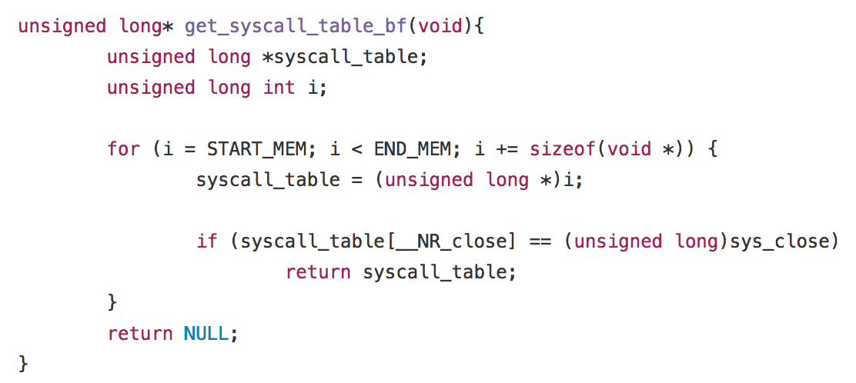
1. Locate the system call table
- dynamically obtain the sys call table address
Notes:
cd /boot -> vii System.map sys_call_table is no longer exported in linux 2.6, use brute force to find it
Dynamically obtain the syscall table address by scannig through the kernel memory
In linux 64bit, PAGE_OFFSET and ULONG_LAX are constants with values that are equal to the start and end addresses of the kernel memory This is to find the syscall table in the kernel memory space area. I do this by comparing the address in syscall_table[__NR_close](starts in the kernel land memory in #define START_MEM PAGE_OFFSET and go incrementing this adress in the loop) with the real syscall table "sys_close". So, if the address is the same, means that we found the syscall table in the kernel memory area.

Slide 8
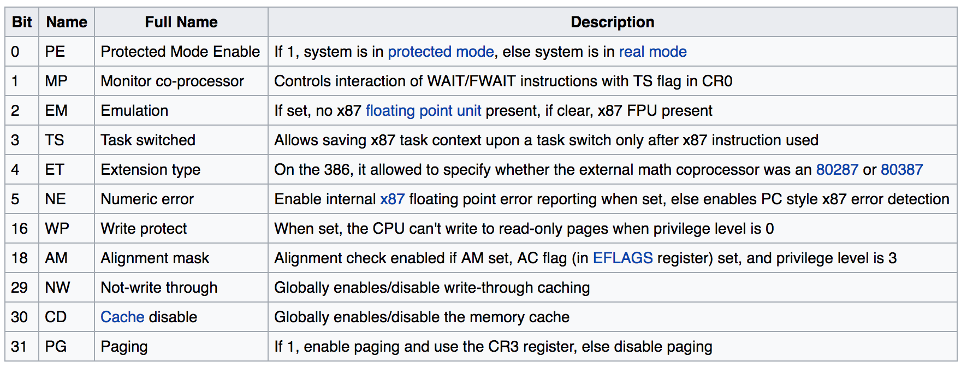

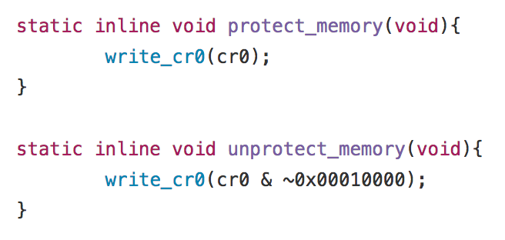
2. Bypassing write protection
x86 Machine - Control Register 0
Notes:
CR0 has various control flags that modify the basic operation of the processor. Step 2: add demo of the wp (write protection) bit set to 1; we are setting it ourselves to 0 by calling // perform the bit operation to set the WP bit to be zero
// to disable the protected mode, bypass the kernel write protection To show that the wp bit in cr0 is set: cat /proc/cpuinfo | grep wp, we should see
Wp yes

Slide 9
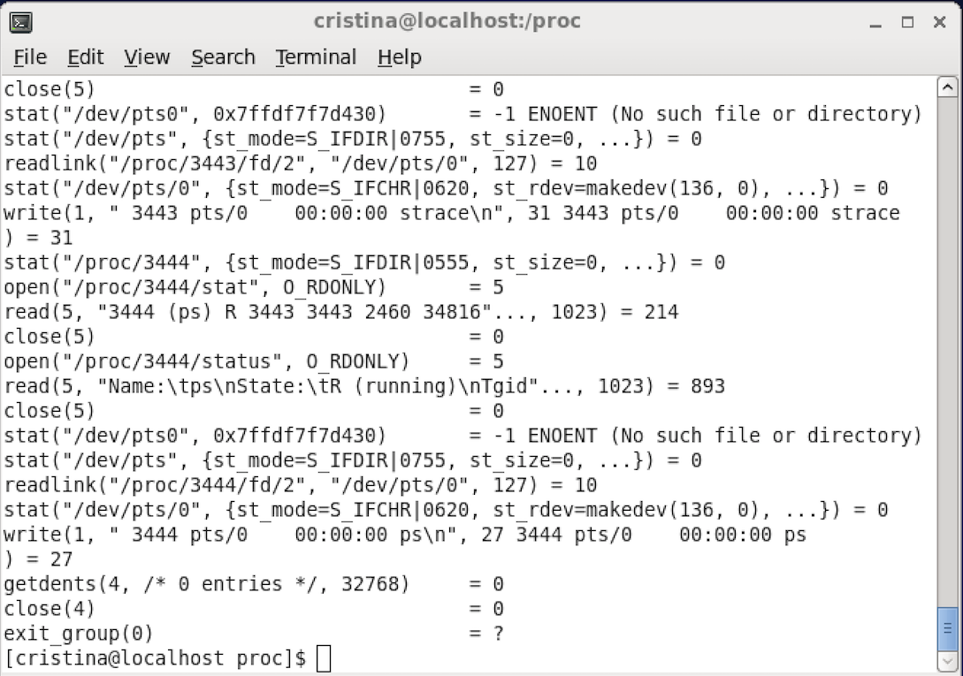

3. Overwrite sys call table entries
strace ps getdents: get directory entries
Notes:
- strace is a diagnostic, debugging and instructional userspace utility for Linux. It is used to monitor and tamper interactions between processes and the Linux kernel, which include system calls, signal deliveries, and changes of process state. - prints a list of system calls made by the program getdents, getdents64 - get directory entries

Slide 10
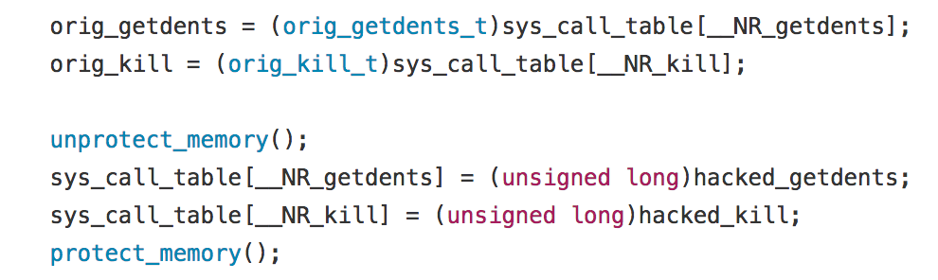

3. Overwriting sys call table entries

Slide 11
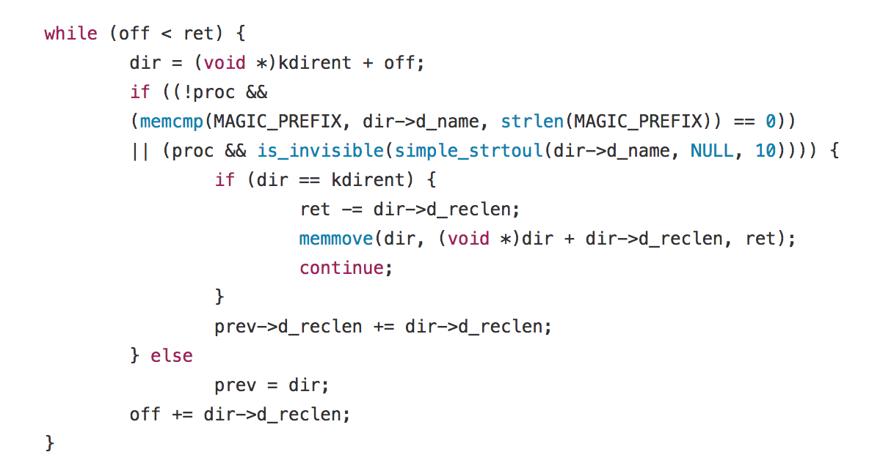
Kernel-level rootkit
Modify/ delete yourself from directory entries (hacked_getdents function)
Notes:
- make invisible both the kernel module and the files starting with magic prefix

Slide 12
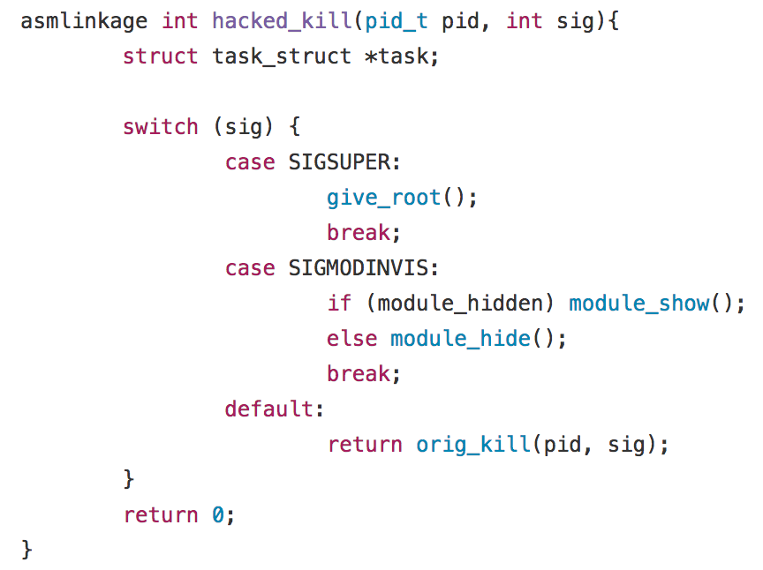
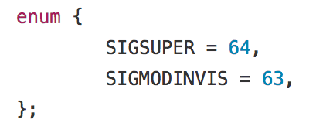
Kernel-level rootkit
Kill Sending a signals makes the module become (in)visible, or the given user become root
Notes:
demo kill

Slide 13
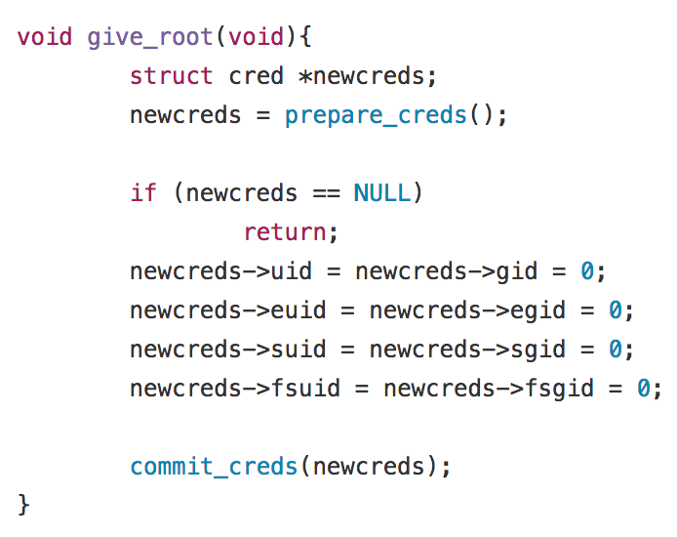
Kernel-level rootkit
Give root permission: alters the current process's credentials to gain root privilege
Notes:
demo making the current user root: mount -a The mount command mounts a storage device or filesystem, making it accessible and attaching it to an existing directory structure. Uid - user identifier
Euid - effective user id
Suid - saved user id
Fsuid - file system user id
Gid - group identifier
Egid - effective group identifier
Sgid - saved group identifier
Fsgid - sile system group identifier

Slide 14
Detection
rootkit detection is difficult, it can subvert the software that is meant to find it
detection methods: using alternative operating system, behavioural-based methods, signature scanning, difference scanning, memory dump analysis
removal is generally complicated or practically impossible
firmaware rootkits: specialized equipment or hardware replacement

Slide 15
Usage
Modern rootkits make other software payload undetectable: - steal user passwords, credit card information, computing resources, conduct unauthorized activities - permitting unauthorised access to an attacker, for example to steal or falsify documents - Conceal other malware (password-stealing key loggers and computer viruses)
Some rootkits may be considered utility applications by their users: - Anti-theft protection: BIOS-based rootkit software on laptops - Conceal cheating in online games - Bypassing Microsoft Product Activation
Notes:
Anti-theft protection: Laptops may have BIOS-based rootkit software that will periodically report to a central authority, allowing the laptop to be monitored, disabled or wiped of information in the event that it is stolen

